Slide 1
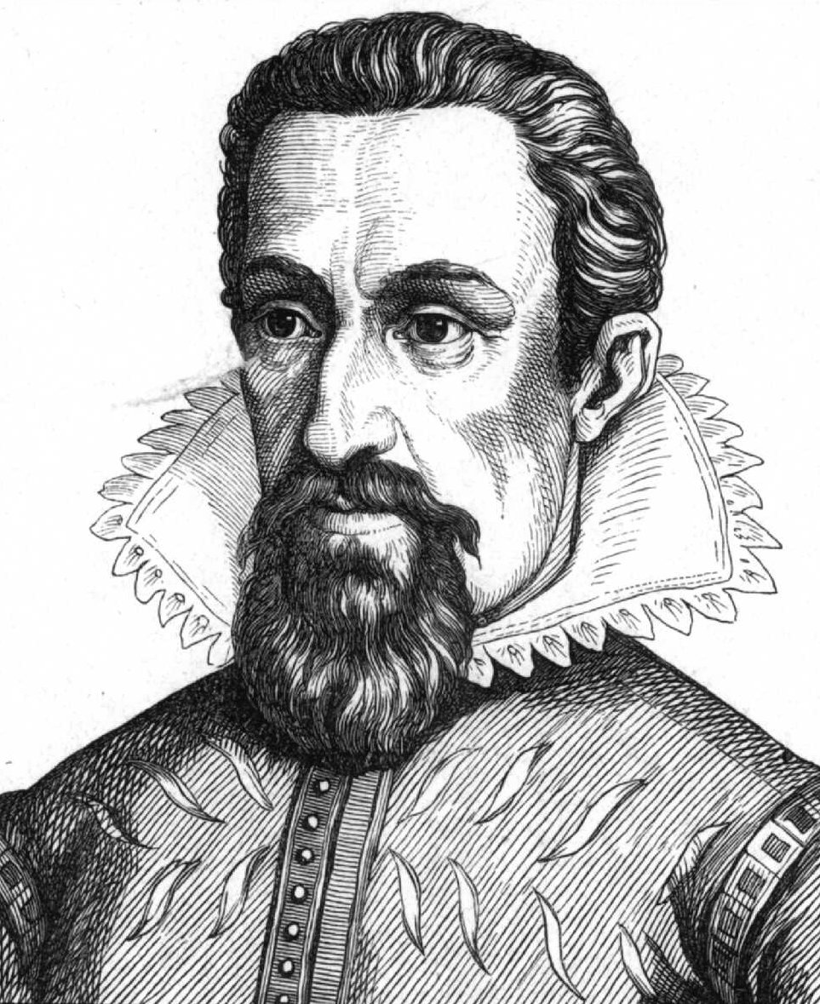
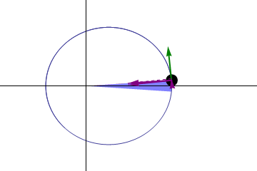
Kepler’s Second Law
A line joining a planet/comet and the Sun sweeps out equal areas in equal intervals of time

Slide 2
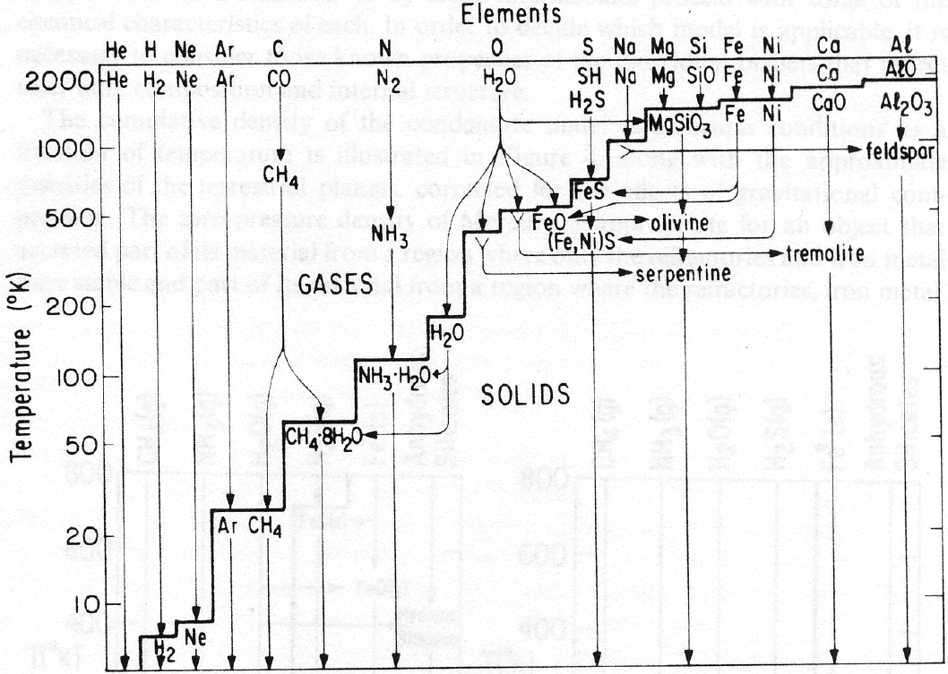
Condensation Sequence
Mercury
Venus
Earth
Mars
Jupiter
Saturn

Slide 3
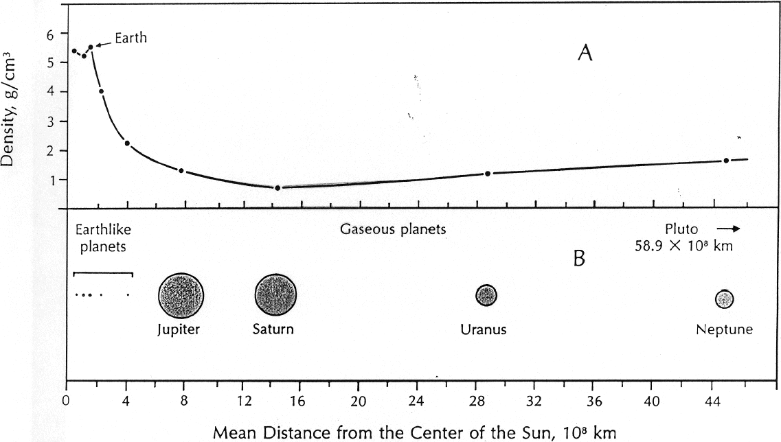
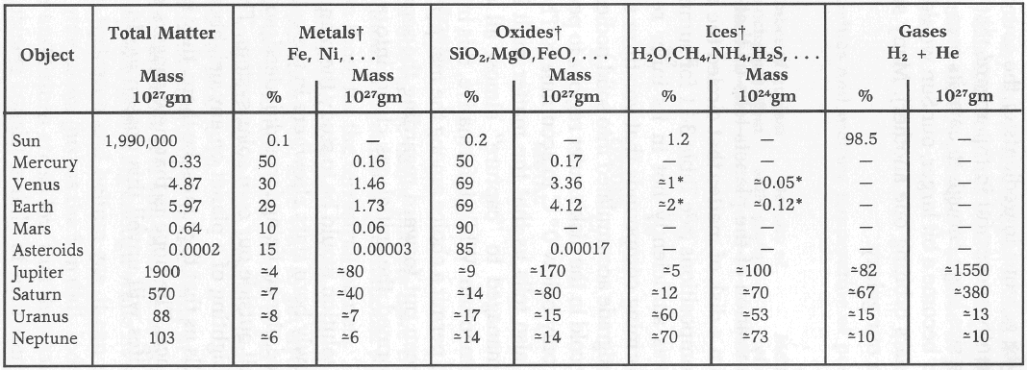
Density and size of planets

Slide 4
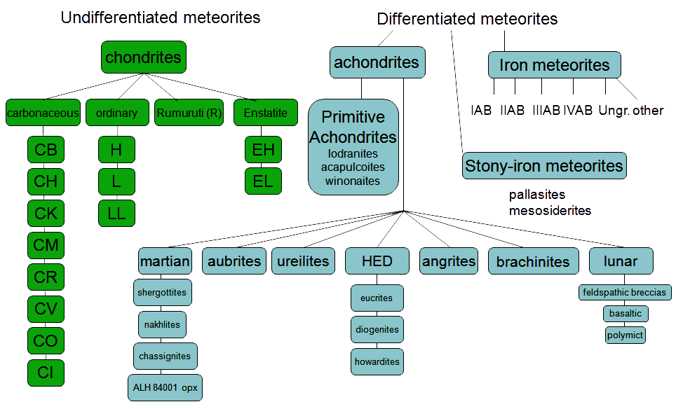
Meteorite Classification

Slide 5
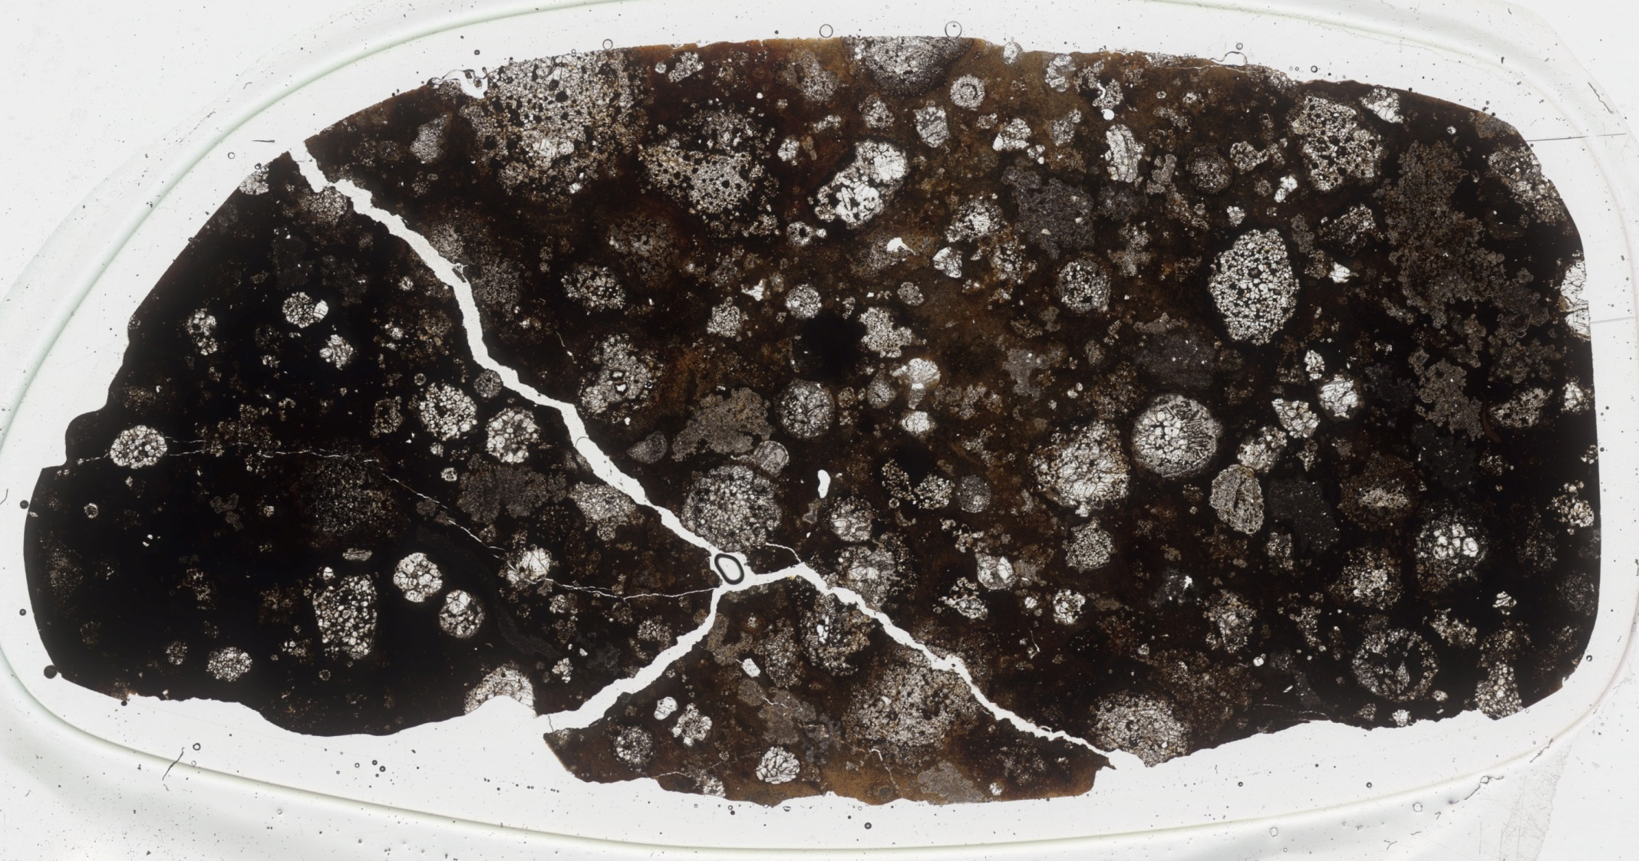
Carbonaceous Chondrite with chondrules

Slide 6
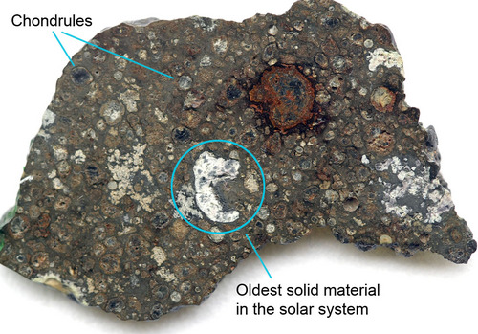
CAI’s – Calcium Aluminum Inclusions
Carbonaceous chondrite NWA 3118. Shows spherical chondrules and white (circled) CAI.

Slide 7
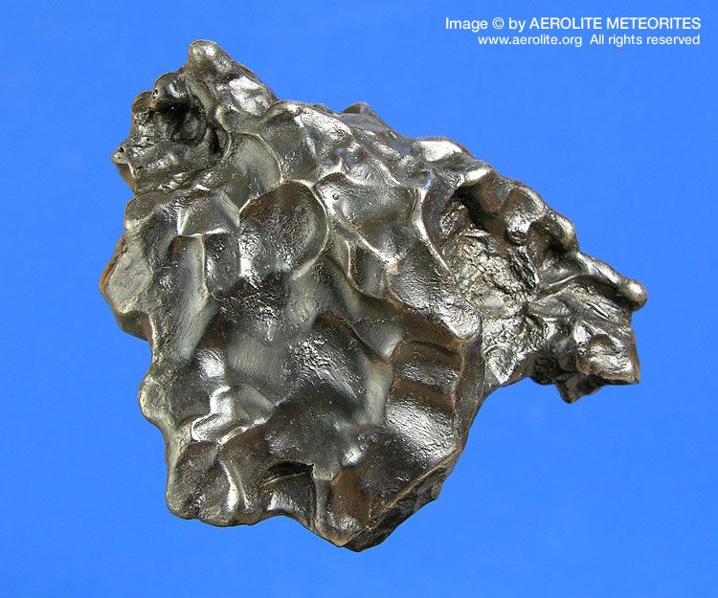
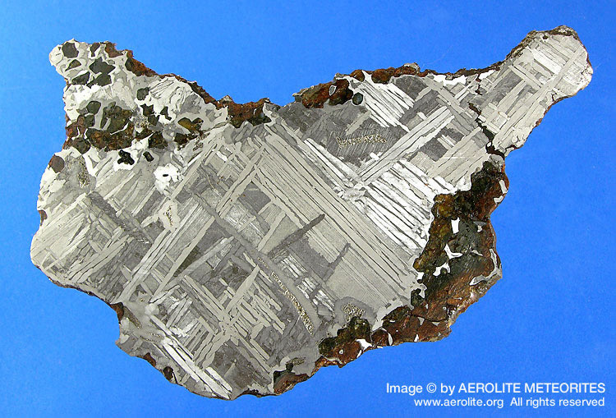
Iron Meteorites
Sikhote-Alin meteorite, observed to fall in eastern Russia in 1947.
Seymchan meteorite, discovered near
Magadan in Russia in 1967.

Slide 8
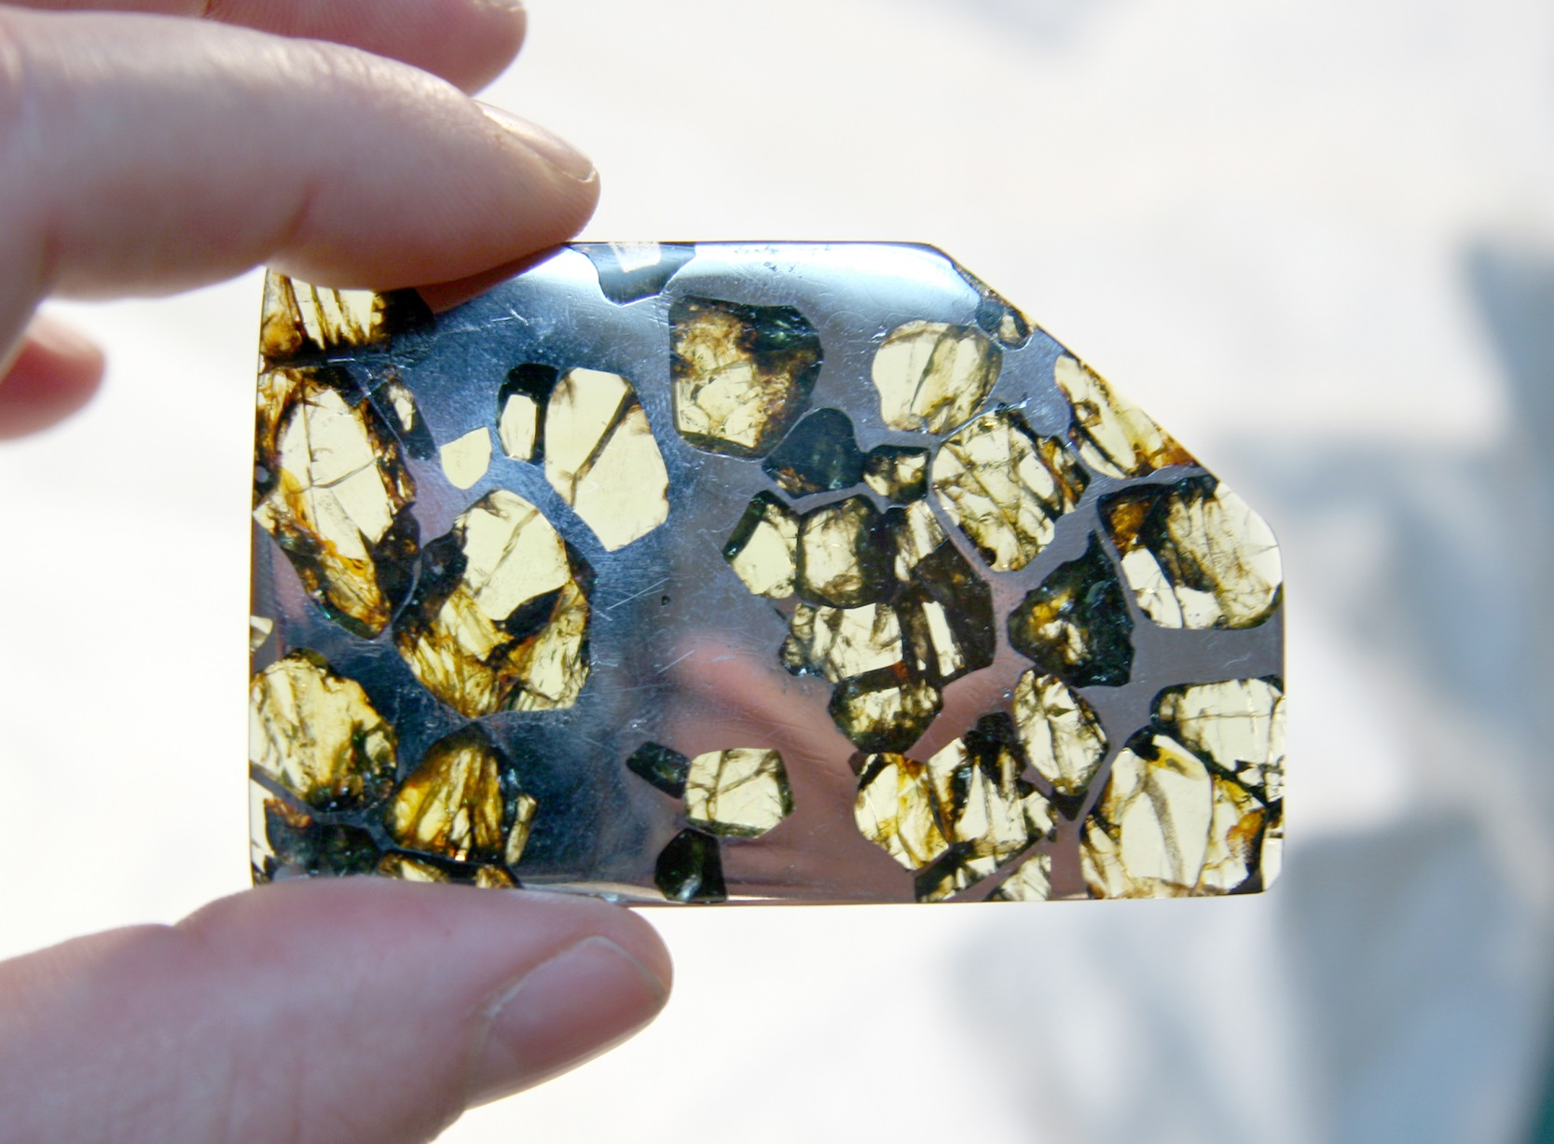
Pallasite
A slice through a rare Pallasite meteorite , Esquel meteorite found in Argentina. Shows
Olivine crystals suspended in Iron.

Slide 9
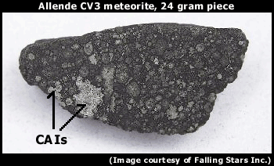
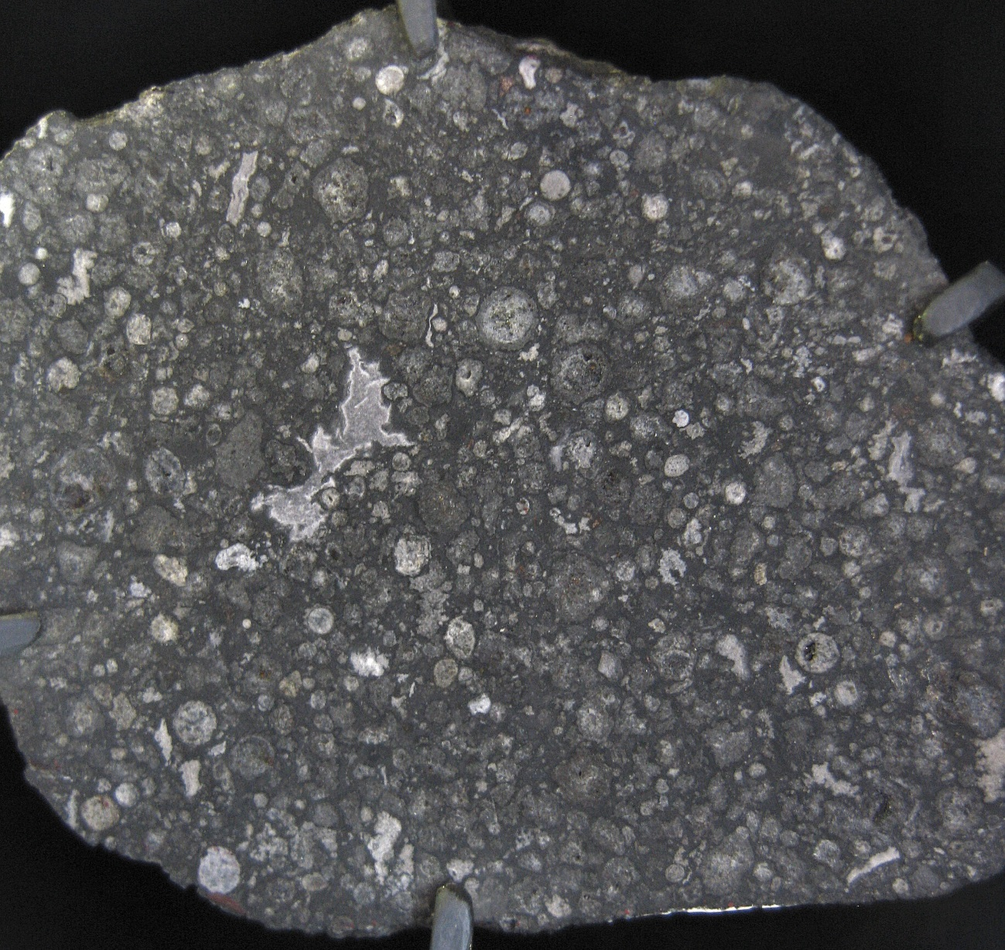
Allende Meteorite
Fell in 1969 near Pueblito det
Allende in Mexico.
~4 tons of fragments fell,
Covering an area about
50 x 10 km.
Largest carbonaceous chondrite
Found on Earth, and as a result
Is also the most studied.

Slide 10
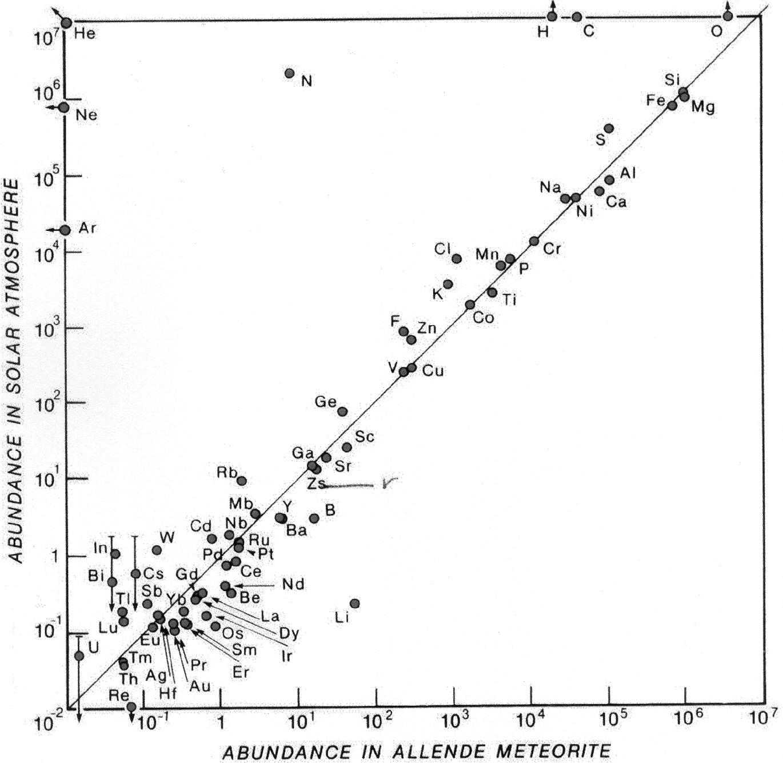
Abundance in Allende meteorite
Except for the most volatile elements (i.e., more volatile than nitrogen), CI carbonaceous chondrites are excellent models of bulk solar system composition and hence may be close to bulk earth composition
While the sun is basically H+He, the Earth is dominated by O, Si, Mg, Fe. Much Fe is in core, leaving rocky earth dominated by O, Si, Mg

Slide 11
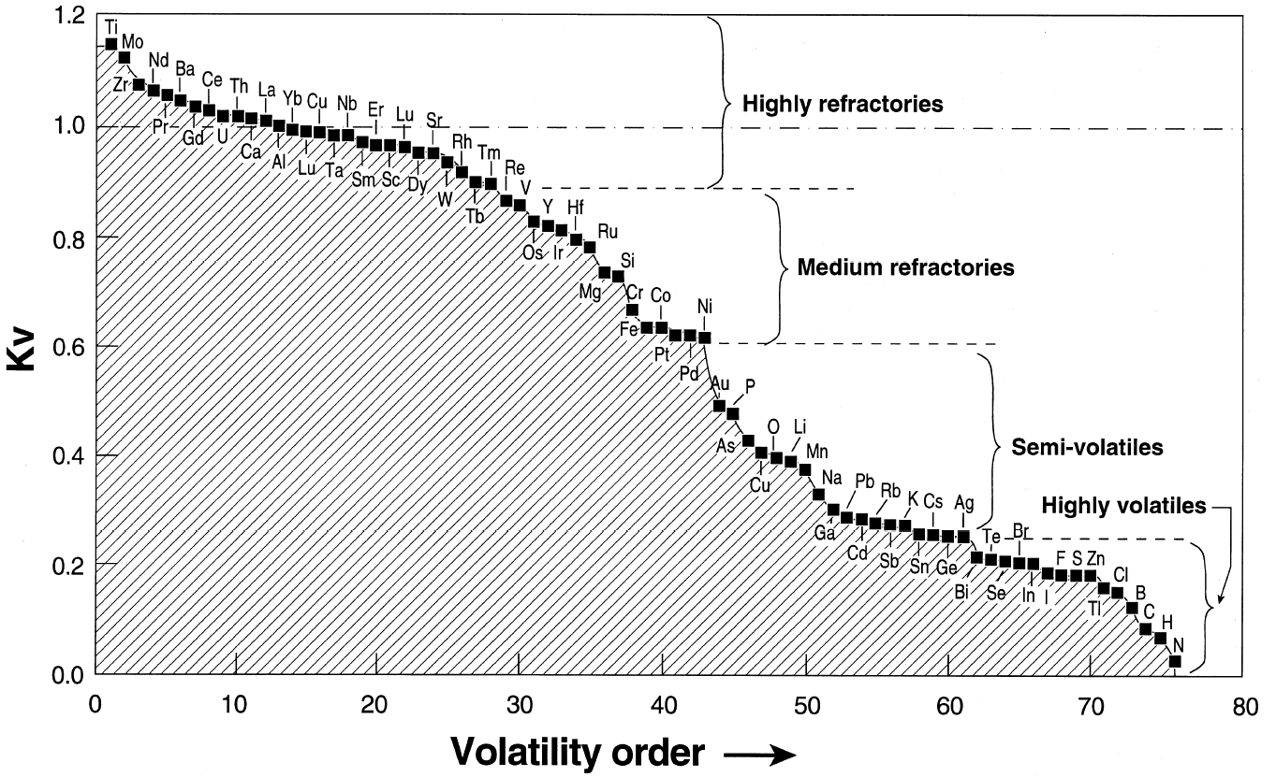
CV vs. CI chondrites and volatility
Among the several classes of carbonaceous chondrites, relative abundance of all elements are controlled by volatility; this plot shows the CV chondrites versus CI. Presumably similar volatility control was active during accretion of the Earth or its source materials.

Slide 12
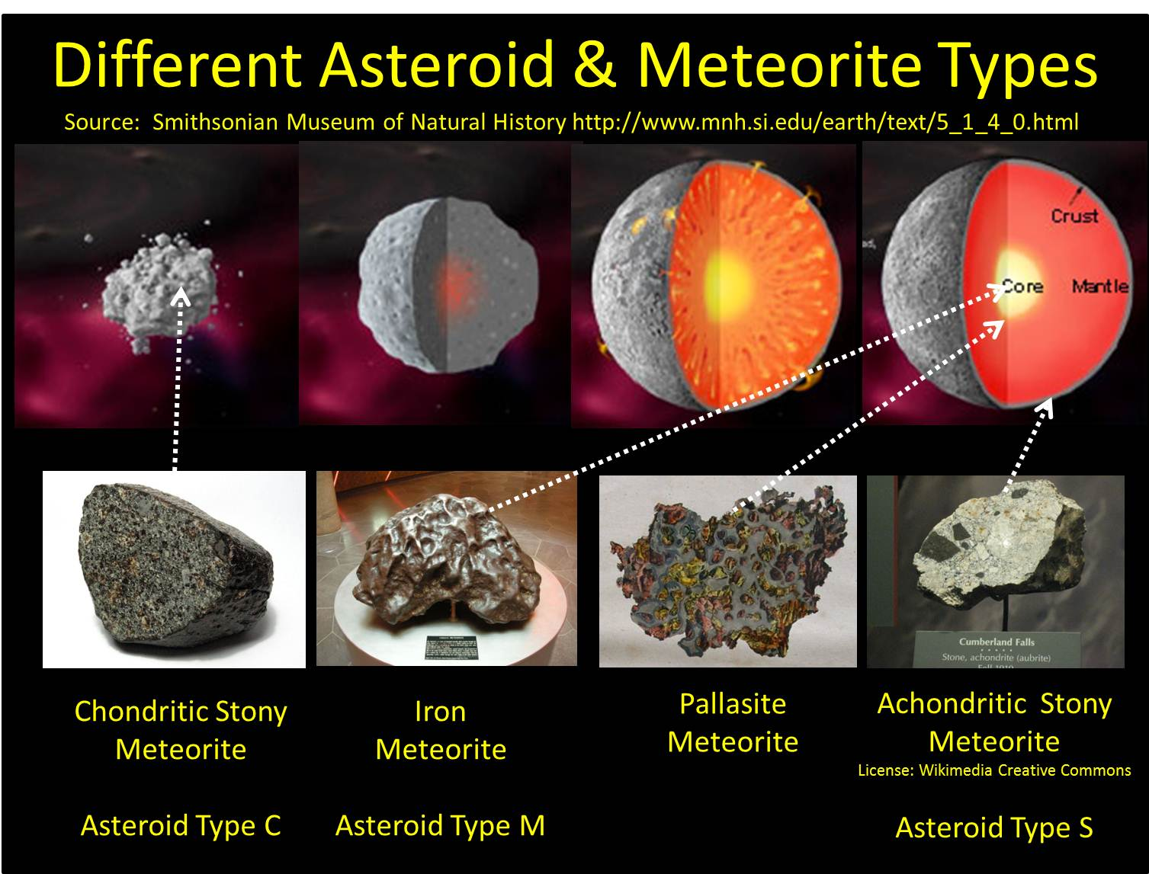

Slide 13
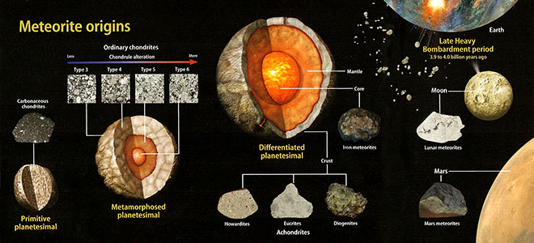
Meteorite classification

Slide 14
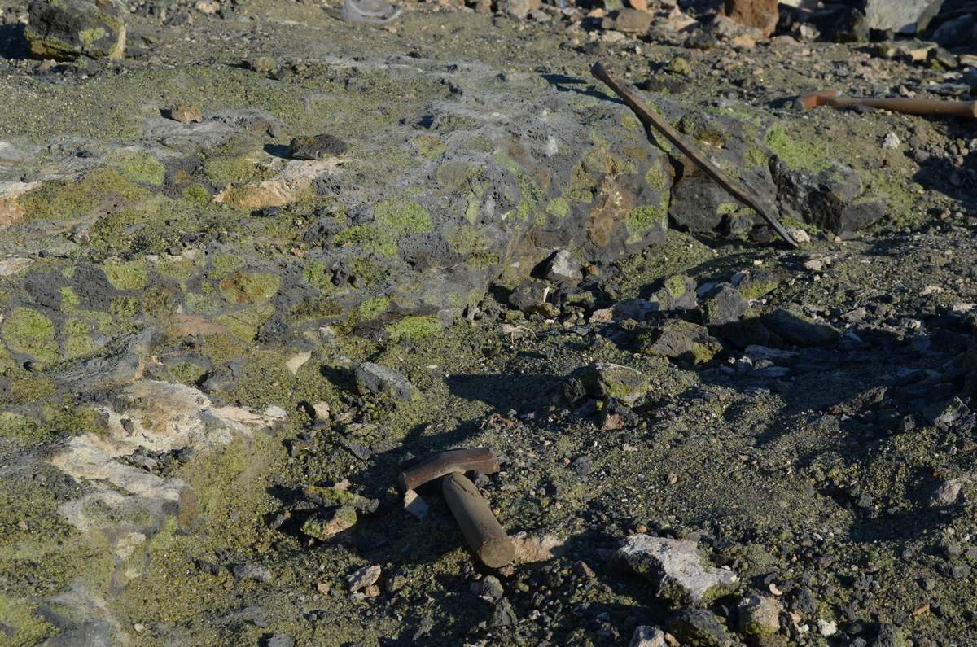
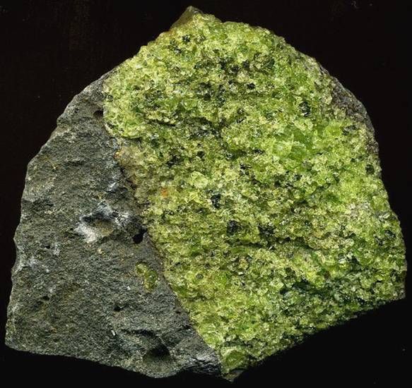
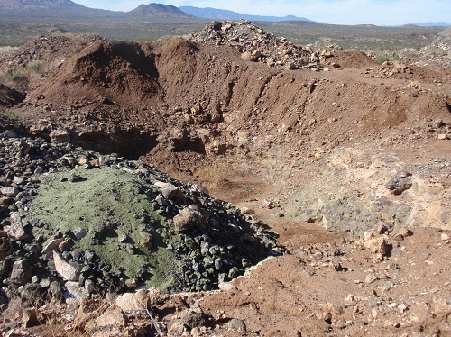
Xenoliths - Peridote Mesa
Peridot Mesa, near San Carlos, AZ

Slide 15
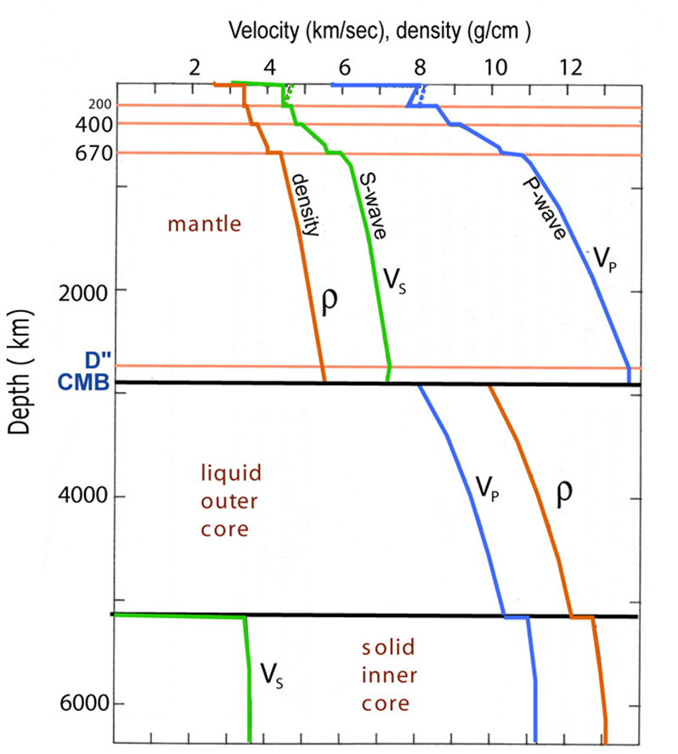
PREM
PREM =
Preliminary
Reference
Earth
Model
[Dziewonski & Anderson, 1981]

Slide 16
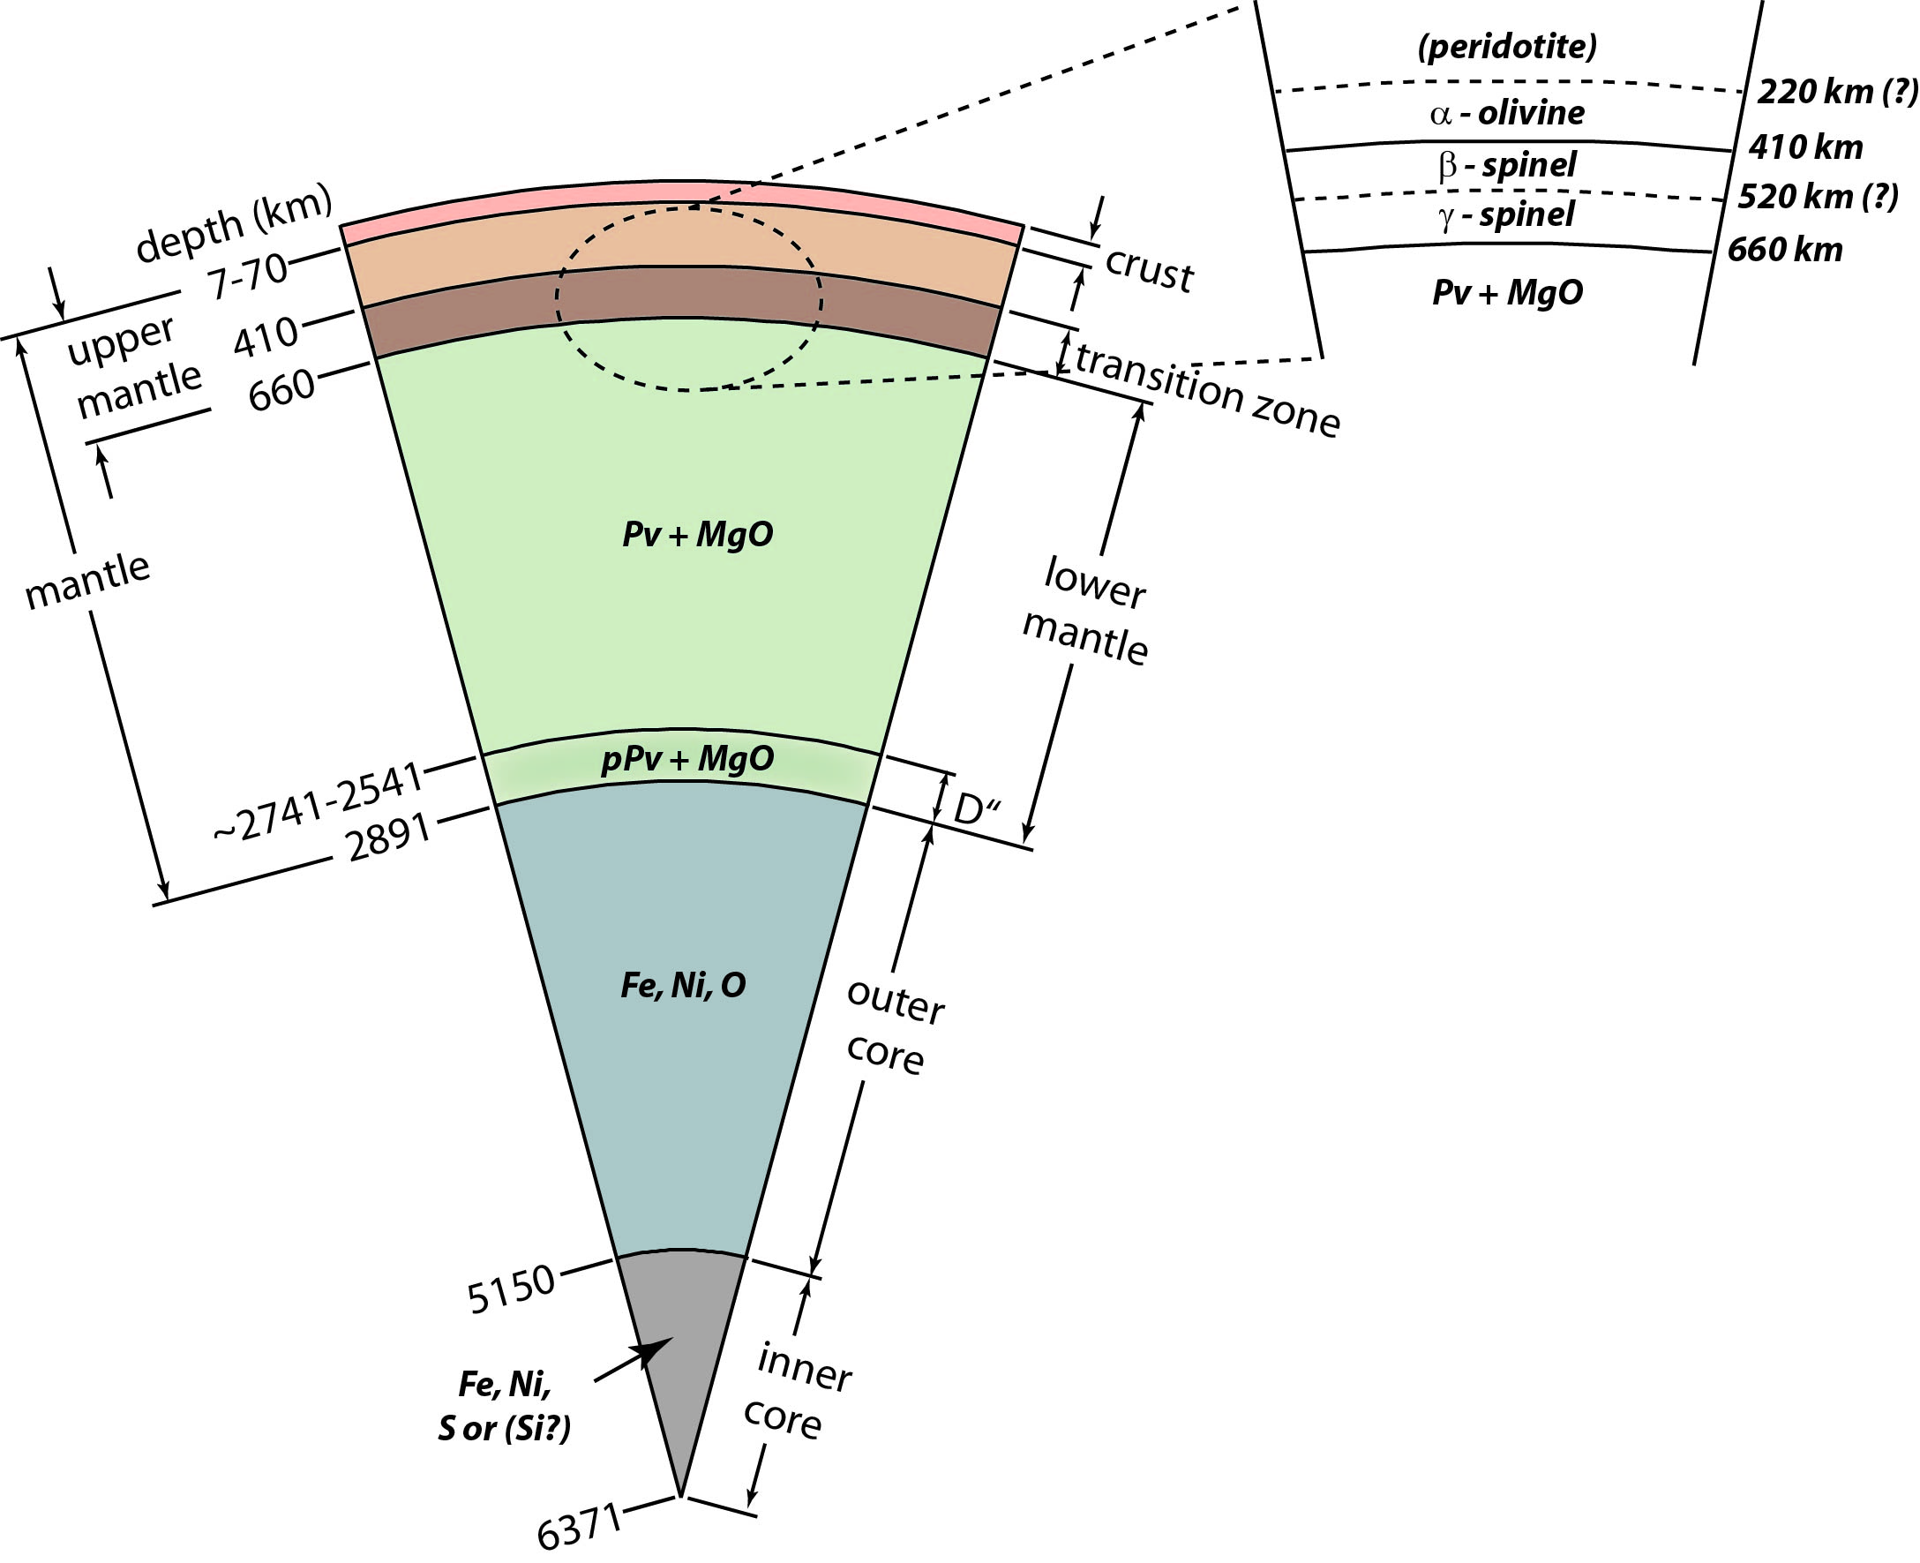
Earth – Compositional Structure

Slide 17
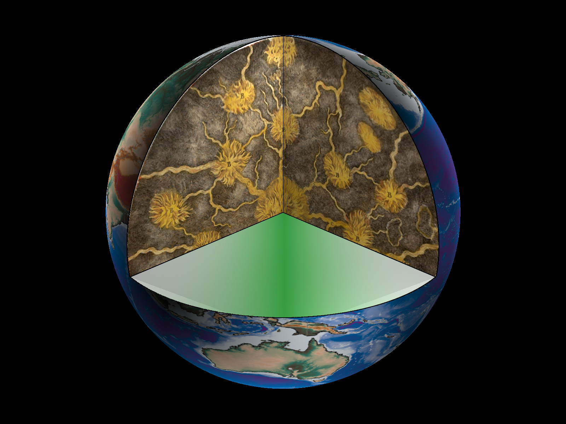
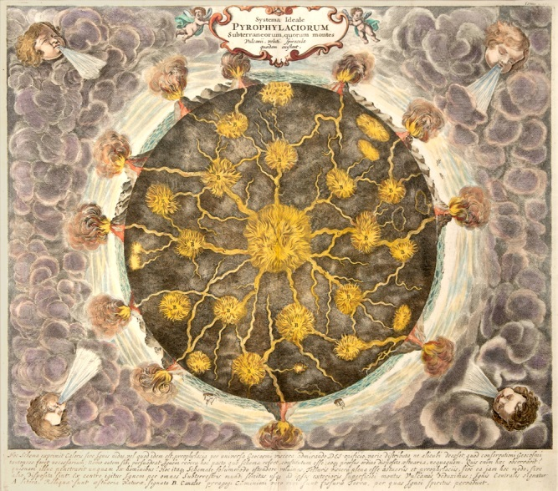
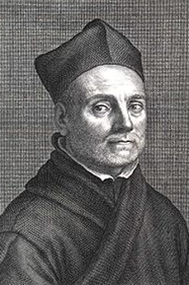
Prior to 1900
Prior to 1900
Althanasius Kircher
Althanasius Kircher
Notes:
Well, prior to the invention of the seismometer, we didn’t know much.
Here is a picture by the 17th century German geologist Althanasius Kircher.
Kircher was interested in volcanoes and his picture of what the inside of the Earth must look like is given here in the
Upper right corner, and spread out into a cross-section of the Earth here in the main picture.
I will keep this main cross-section up through many of the next slides. Here we have just have the surface of the Earth – but cut into it
All of the way down to the center of the Earth.
So, what did we know? Well, Kircher envisioned a connectedness between magma sources feeding the worlds volcanoes and drew the Earth’s interior as such. But, prior to 1900 all we really had were artists conceptions.

Slide 18
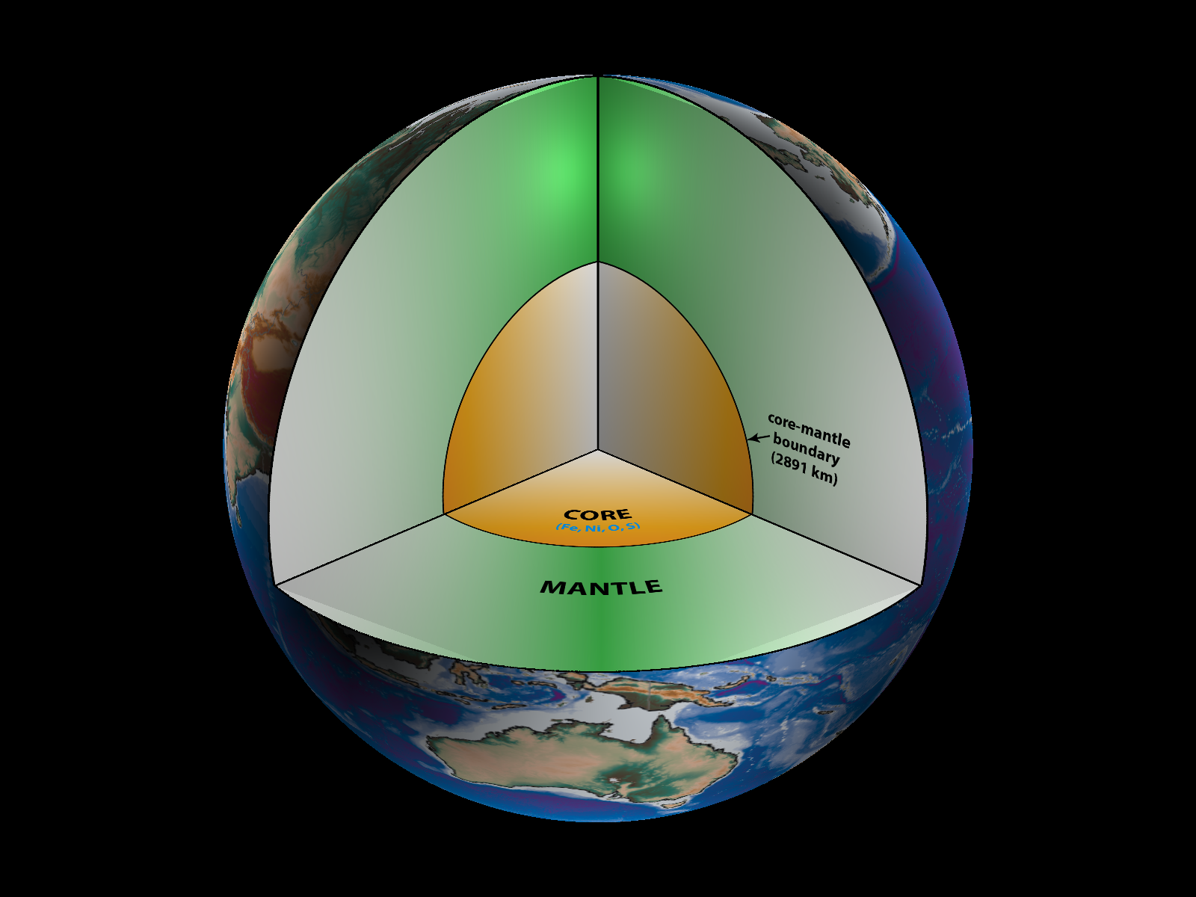
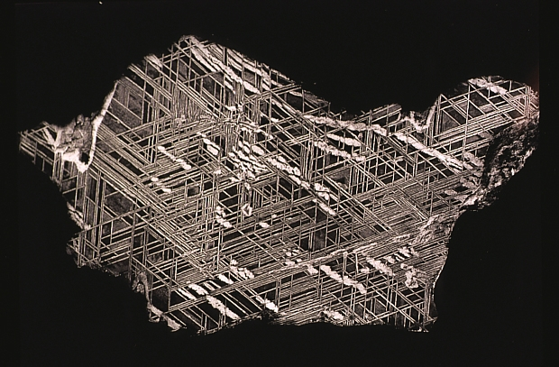
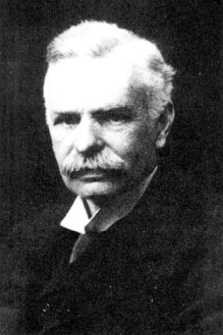
1906 – Earth’s Core
Richard Oldham
Notes:
The Discovery of the Earth’s Core is generally attributed to Richard Oldham. This was the first real insight to
The interior structure of the Earth. He determined that the Earth had a core, and that this was 2891 km deep.
We don’t have any actual rock samples from the Earth’s core, but by measuring seismic wave speeds, we can see
That the core has a density that is about 10% less than pure Fe.
Since we believe that the Earth was created by the accretion of meteoritic material out of the solar nebula, we generally
Look to Fe-Ni meteorites as an analog to what the core must be composed of.
In general we suspect the core is primarily composed of Fe, but because it is less dense than pure Fe must contain some
Lighter elements, which we suspect are O, and S.

Slide 19
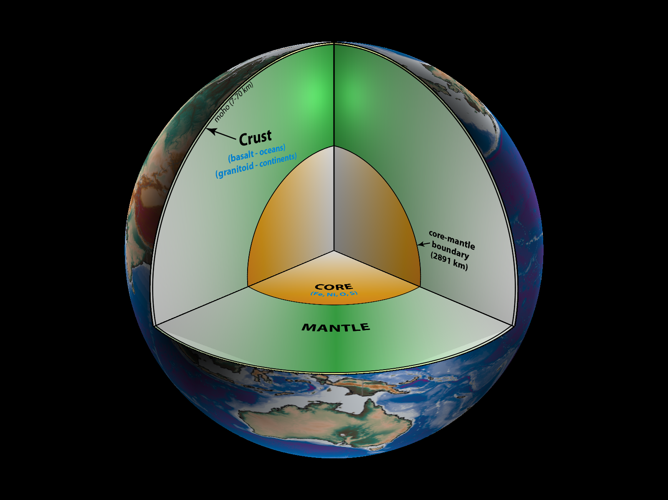
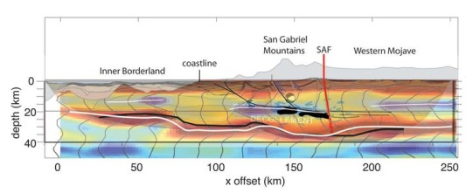
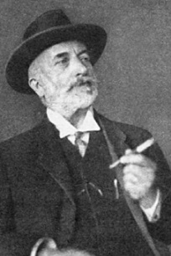
1909 – Crust Mantle Boundary (MOHO)
Andrija Mohorovičić
Notes:
In 1909 – Andrija Mohorovicic discovered that there is a hard boundary that separates the Earth’s crust, and its mantle.
This boundary is named after him – called the moho – and varies in thickness from about 7 km (beneath the oceans) down
To almost 70 km beneath the continents.
Almost all the work I do is so much deeper than this, and we won’t talk about the crust any more today. Students in my classes
Sometimes get annoyed when I refer to the crust as just this thin scum at the Earth’s surface – and I usually just remove it from
My models as it just generates a lot of noise in the seismic recordings.

Slide 20
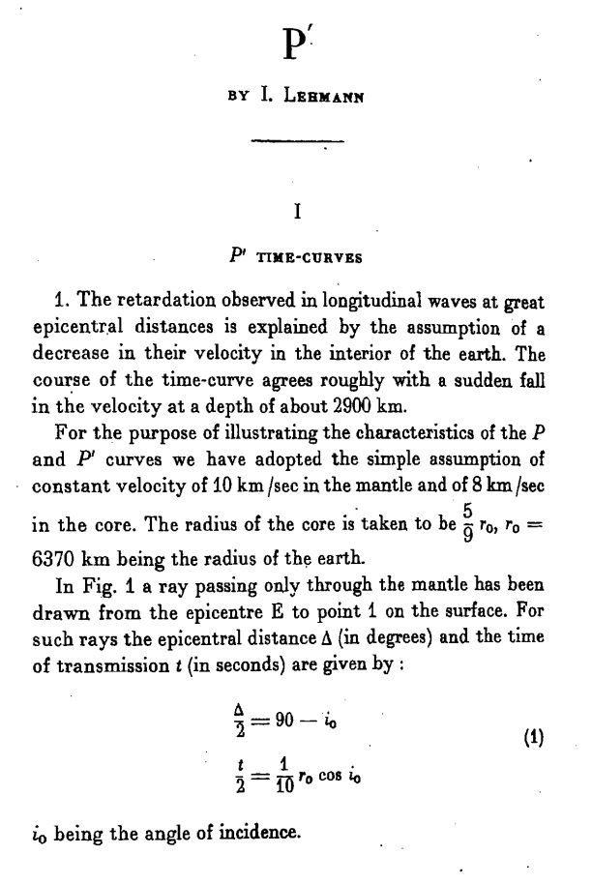
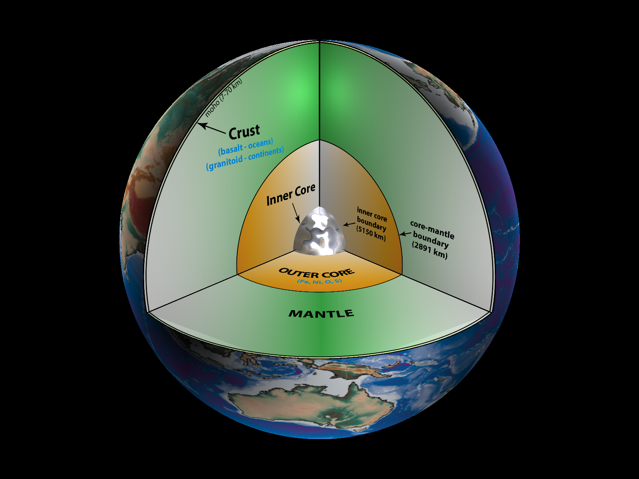

1936 – Inner Core
Inge Lehmann
Notes:
In 1936 – Inge Lehmann discovered that the Earth’s core was actually divided into a solid inner-core, and a fluid outer-core.
In the upper right I have a scanned image of the first page of her paper, which I love. It’s title has to be the shortest title
Of any paper I’ve ever seen. It’s just called “p-prime” which is the name of the seismic phase she discovered that reflected
Off of the inner core boundary.

Slide 21
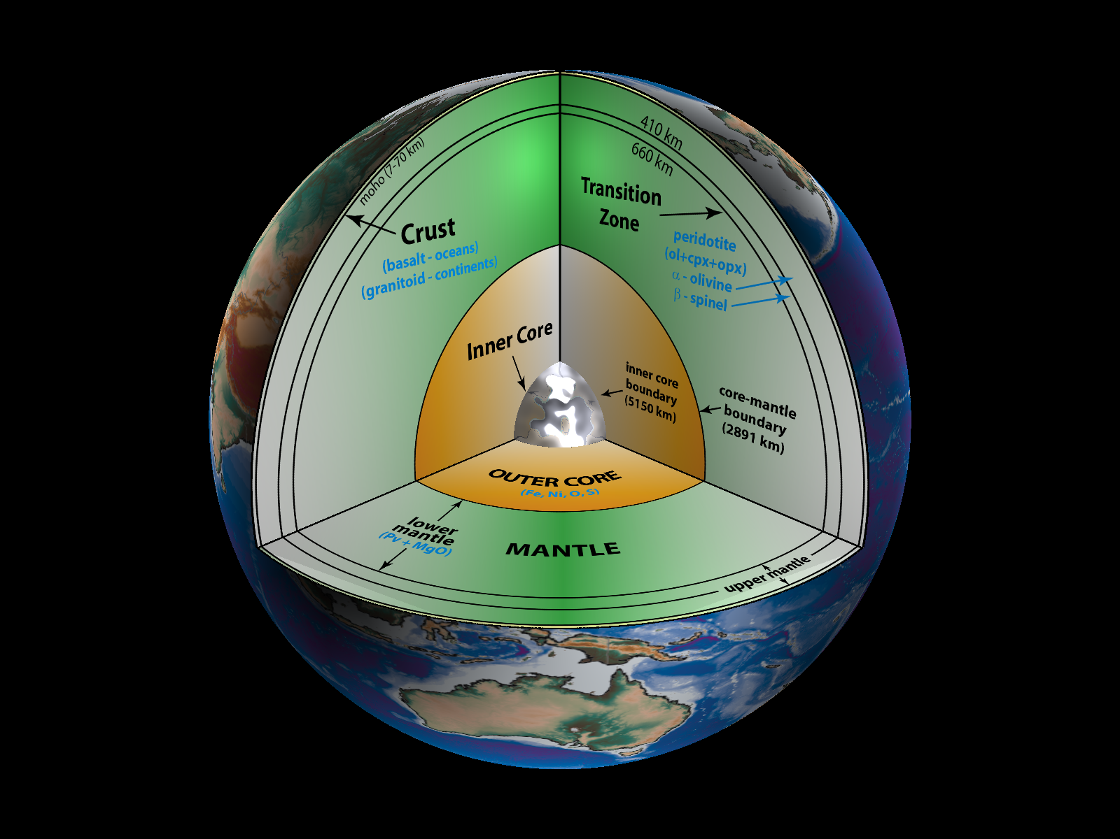
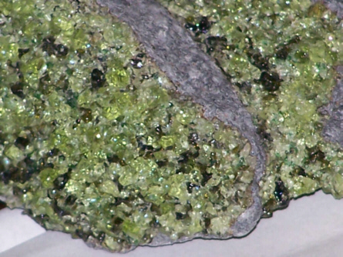
1960’s – Mantle Transition Zone
Niazi, Anderson, Johnson,
Others …
Notes:
Moving into the 1960’s we started to accumulate evidence by a large number of people that there were two changes
In composition at depths of 410-km and 660-km.
This depth region between 410- and 660-km is what we now call the mantle transition zone.
It’s existence is explained by considering the composition of the upper mantle.
We do have samples of rocks that have erupted out of the mantle, which are a mineral assemblage called peridotites shown
In this picture.
These peridotites are about 70% or more made of olivine – the August birthstone.
Some people do experiments where they take minerals and rocks and squeeze them to high pressures and temperatures, similar
To conditions found deep in the Earth.
What happens is that when you squeeze olivine to pressures equivalent to 410-km depth the crystal structure of olivine actually gets squashed into a denser form – it is the crystal form called Beta-spinel. We still have the same composition below 410-km, its just that the olivine is smashed into a more compact form. This has a 10% increase in density which makes seismic waves reflect off of the boundary.
At 660-km depth this olivine actually breaks down into two different minerals – one called perovskite and the other called magnesiowustite. These new minerals are also denser, and we have another 10% increase in density which also makes seismic waves reflect off this boundary.

Slide 22
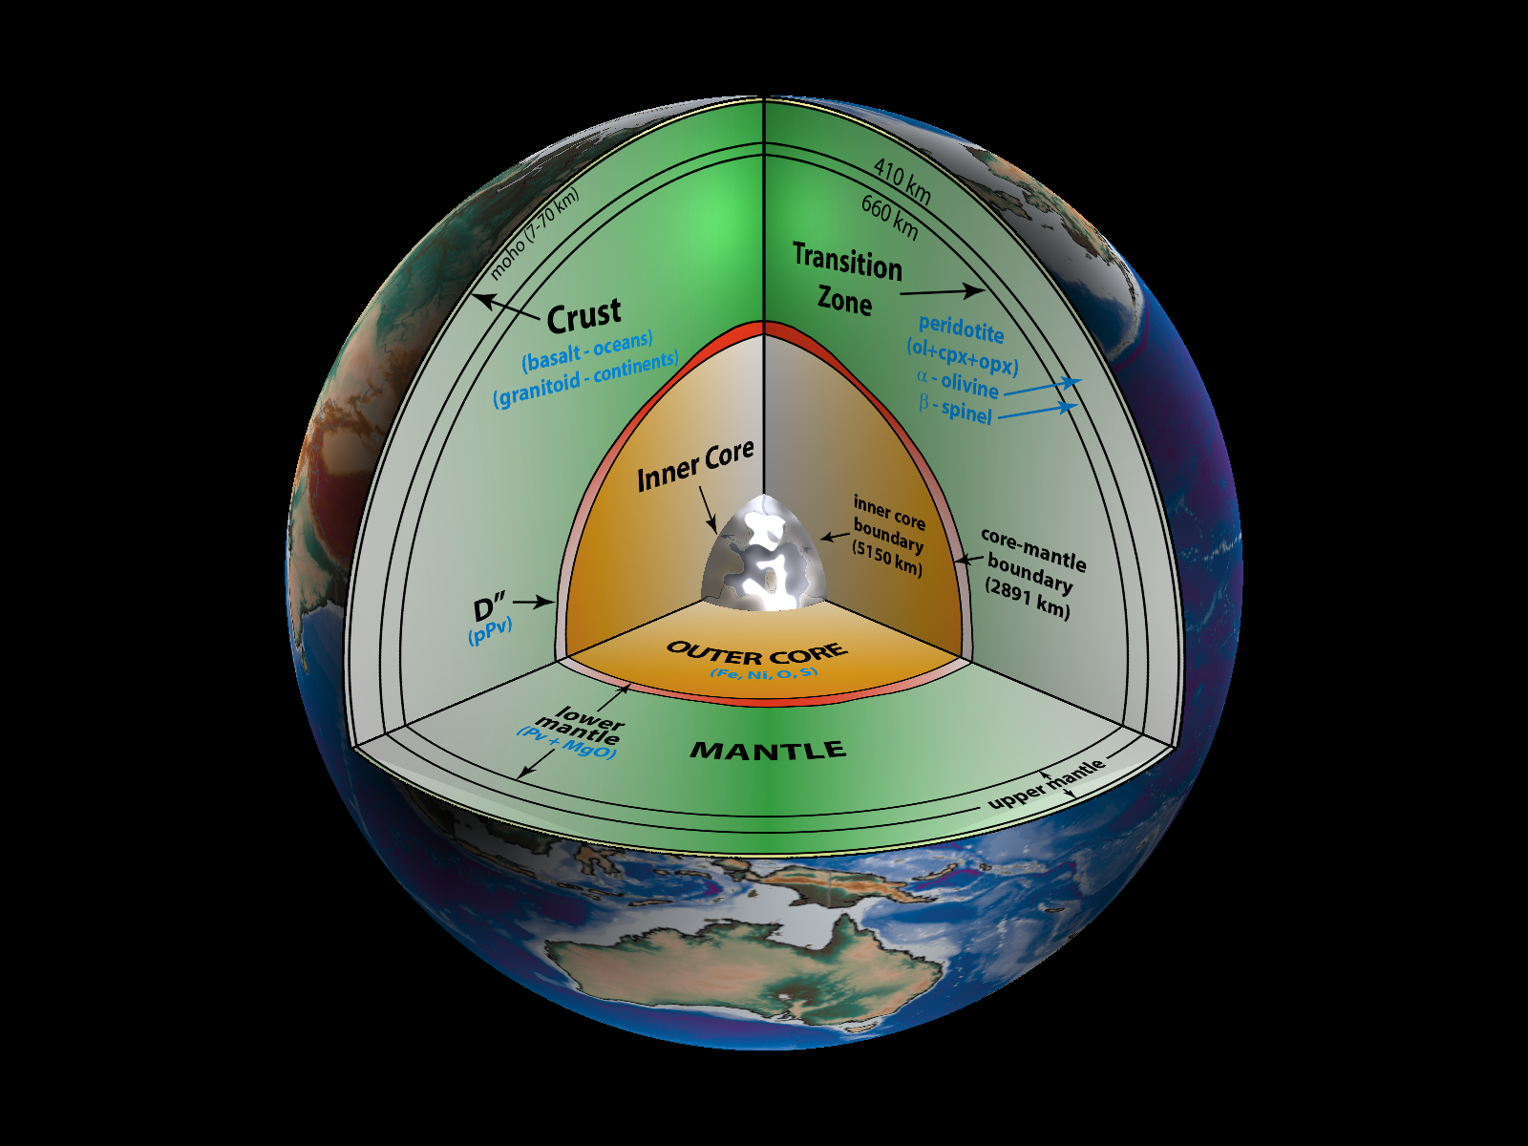
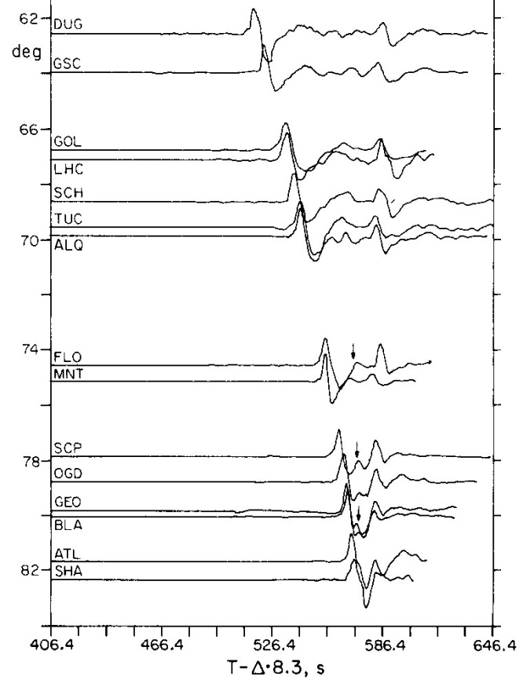

1983 – D” discontinuity
Thorne Lay
Notes:
Moving just a couple years past the PREM model, Thorne Lay discovered another discontinuity just about 200 km
Above the core-mantle boundary. We call this the D-double prime discontinuity, which has its roots back to early work
That divided up the lower mantle first into a layer called the D-layer, and then when it was determined the lowermost
Part of this D-layer looked different, they subdivided it into the D-prime and D-double prime layers.
It wasn’t until about 2005 when the possible origin to this layer was determined. It was a triumph for researchers who
Do first-principles computations. In their computations they discovered that the dominant mineral of the lower mantle-
Perovskite- should compress down to a tighther crystal structure which they called post-perovskite at about 200 km above
The CMB. The existence of postPerovskite was then confirmed by the people who do the high pressure rock squeezing
Experiments.

Slide 23
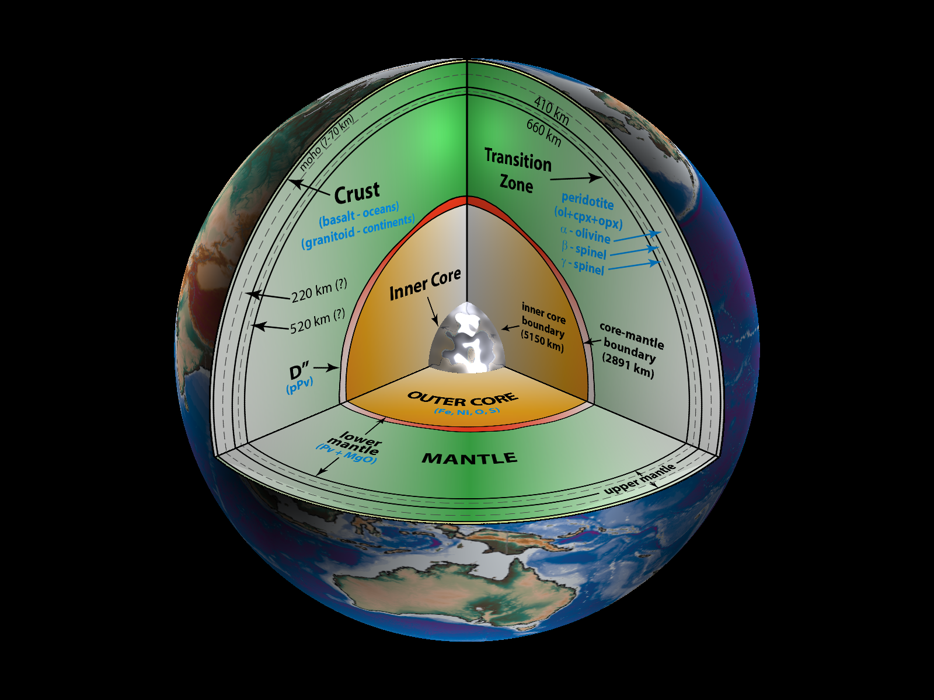
Intermittent discontinuities
Observations:
220 km: (Lehmann discontinuity)
520 km: β- to γ-spinel.
300 km: stishovite to coesite transition.
F-layer: top of outer core.
Notes:
Since the discovery of the D” discontinuity, there has been a flurry of observations of other possible layering, e.g., at depths of 300 or 520 km. However, these layers do not seem to be globally continuous.

Slide 24
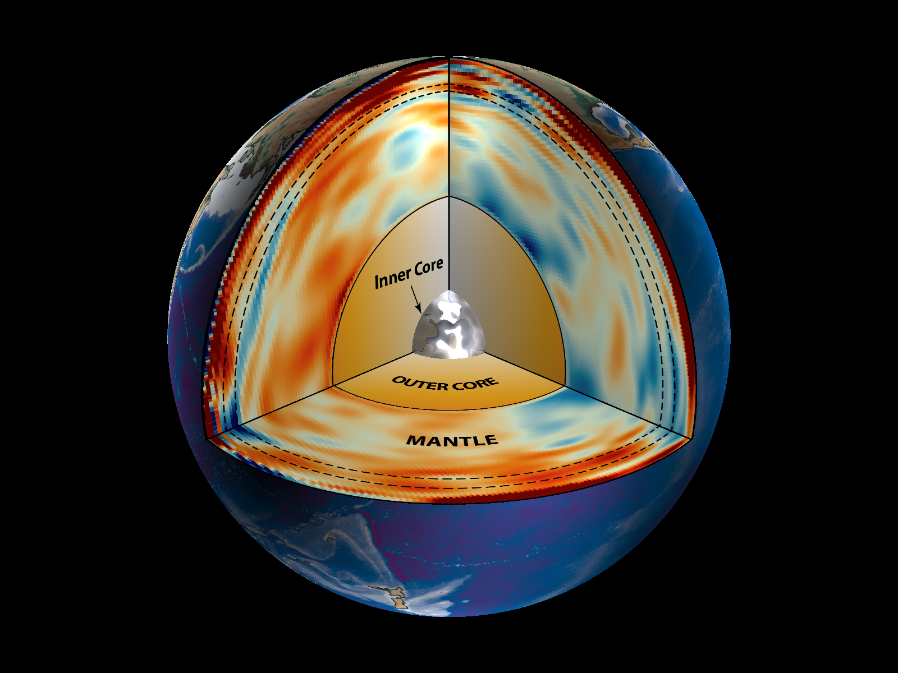

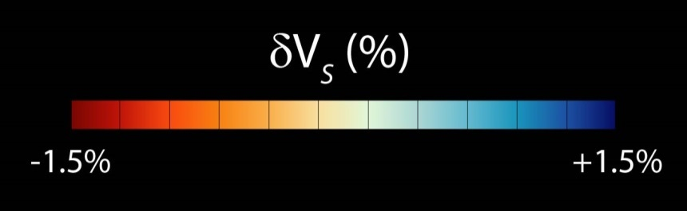
1990’s – 3D seismic variations
Jeroen Ritsema
[Model S20RTS]
Notes:
Since the 1990’s two major things happened. (1) Global digital seismic data became available, and (2) computing power got large enough to start doing large scale inversions using all of these data.
What resulted was a proliferation of people doing “tomography” – similar to doing an ultra-sound of the Earth.
This is one such model result. What is shown is not actual seismic velocity, but in this case deviations, in percent, from the 1-D average PREM model.
In general red colors are always used to show that seismic waves are slower in these regions and blue colors are used to show that seismic waves are faster in these regions. What came out of these simulations was incredible.

Slide 25
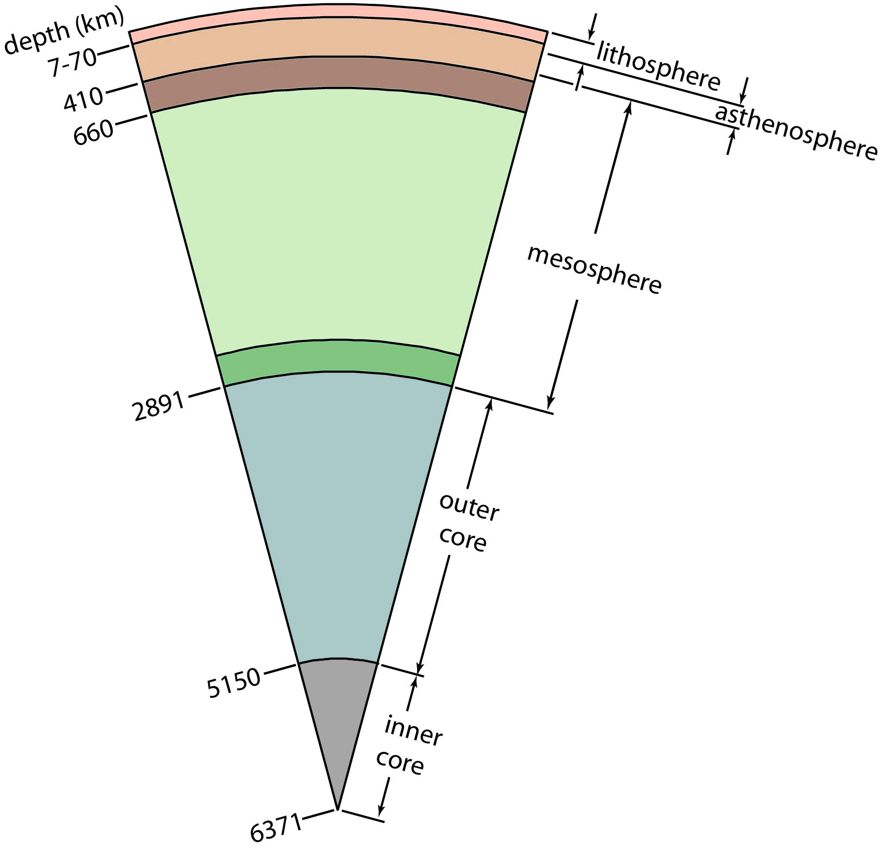
Earth – Mechanical Structure

